Slide 1
Panimalar Engineering College
Computer Science Engineering
NTRU-ENCRYPTED PAYMENT GATEWAYS FOR QUANTUM-RESISTANT SECURITY
Team Members
Jaya Ananda Balaji K
Vigneshwaran P K
Sai Charan R
Guide
Elangoval S Durai
Associate Professor

Slide 2
Introduction
In the realm of digital commerce, the proliferation of online transactions has undeniably revolutionized the way we conduct financial activities. However, amidst the convenience and efficiency offered by electronic payment systems, the persistent threat of cyberattacks looms large, particularly with the advent of quantum computing.
The implementation of NTRU-encrypted payment gateways represents a paradigm shift in cybersecurity, offering a quantum-resistant solution to safeguard sensitive financial data exchanged in online transactions.
By employing advanced cryptographic techniques, including key generation, encryption, and decryption processes, the project aims to create a secure infrastructure that instills trust and confidence among users and stakeholders alike.

Slide 3
Existing System
The existing system for payment gateways typically comprises several interconnected components aimed at facilitating secure and efficient online transactions. At its core, the system involves communication between the user's web browser or device and the merchant's website or application.
This interaction occurs over the internet and relies on various protocols such as HTTP, HTTPS, and SSL/TLS to ensure data encryption and secure communication channels. Upon initiating a transaction, the user enters payment information, which is then transmitted to the payment gateway for processing. The payment gateway acts as an intermediary between the user, the merchant, and the financial institution, verifying the transaction details, authenticating the user's identity, and securely transferring funds.
Overall, the existing system strives to balance convenience with security, leveraging a combination of technology and protocols to facilitate seamless and safe online payments.

Slide 4
Proposed System
The proposed methodology for implementing "Shielding Online Transactions: NTRUEncrypted Payment Gateways for Quantum-Resistant Security" involves several key steps. Firstly, a comprehensive analysis of existing payment gateways and their vulnerabilities to quantum computing threats is conducted. This analysis informs the selection of the NTRU encryption algorithm as the cornerstone of the proposed solution due to its quantum-resistant properties. Next, a thorough design phase focuses on integrating the NTRU encryption algorithm into the payment gateway infrastructure. This involves modifying the existing architecture to incorporate NTRU encryption for securing sensitive transaction data. Additionally, a robust authentication mechanism is designed to ensure the integrity and legitimacy of transactions. Following the design phase, the implementation process involves the actual integration of NTRU encryption into the payment gateway system. This requires careful testing and validation to ensure compatibility, functionality, and security. Moreover, user training and education programs are developed to familiarize stakeholders with the enhanced security measures and promote adoption.

Slide 5
Literature Survey
Title: A Third-Party Mobile Payment Scheme Based on NTRU Against Quantum Attacks
Year: 2020
Authors: Li, Q., Wang, Y., & Liu, J
The paper utilizes the NTRUEncrypt cryptosystem, known for its resistance to quantum algorithms, to secure transactions. The scheme involves a third-party entity to facilitate secure communication between users and merchants, ensuring confidentiality and integrity during transactions. By leveraging NTRU encryption, the system provides a robust defense against quantum computing threats, enhancing the security of mobile payment platforms in anticipation of future advancements in quantum technology. The paper presents a robust third-party mobile payment scheme based on NTRU, offering heightened security against quantum attacks. It provides efficient facilitation for secure transactions, ensuring resilience against emerging cryptographic threats in mobile payment systems.

Slide 6
Literature Survey
Title: Key Technologies for Security Enhancing of Payment Gateway
Year: 2018
Authors: Xuewang Zhang and Linlin Wang
The paper addresses critical aspects of securing payment gateways in e-commerce. The authors highlight the necessity of robust security measures, particularly in light of vulnerabilities such as the breakdown of hash algorithms like MD5. They propose a solution that focuses on enhancing security through a fusion-based approach, blending SSL and SET protocols. This approach aims to optimize and integrate AES algorithms, establish secure hash algorithms, and design security proxies and micro CA systems to bolster the security of payment gateways. It emphasizes enhanced security through the integration of advanced encryption standards like AES and robust protocols such as SSL/SET. This ensures that sensitive payment information remains protected from potential cyber threats, bolstering trust and confidence among users. Additionally, the implementation of a micro Certification Authority (CA) system streamlines certificate management processes, facilitating efficient issuance and maintenance of digital certificates.

Slide 7
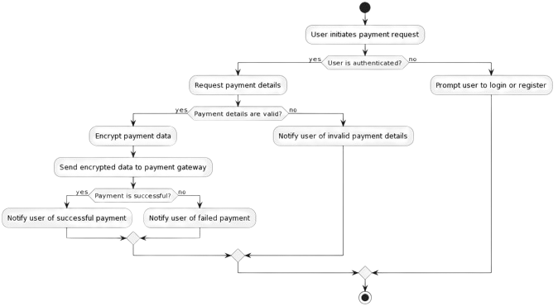
System Architecture

Slide 8
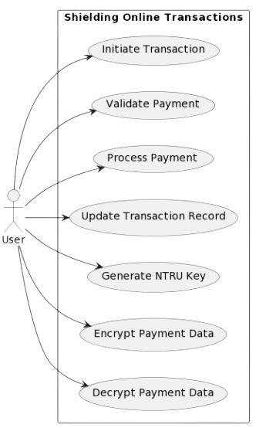
Use Case Diagram

Slide 9
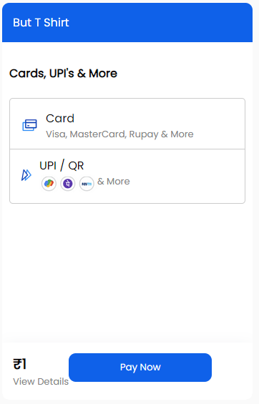
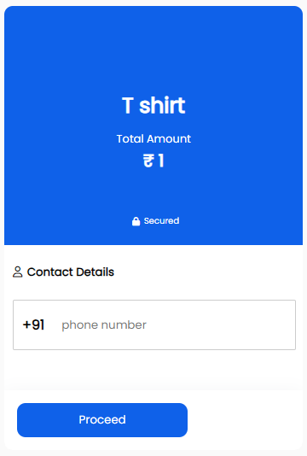
Screenshots

Slide 10
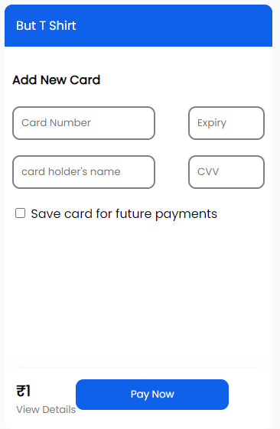
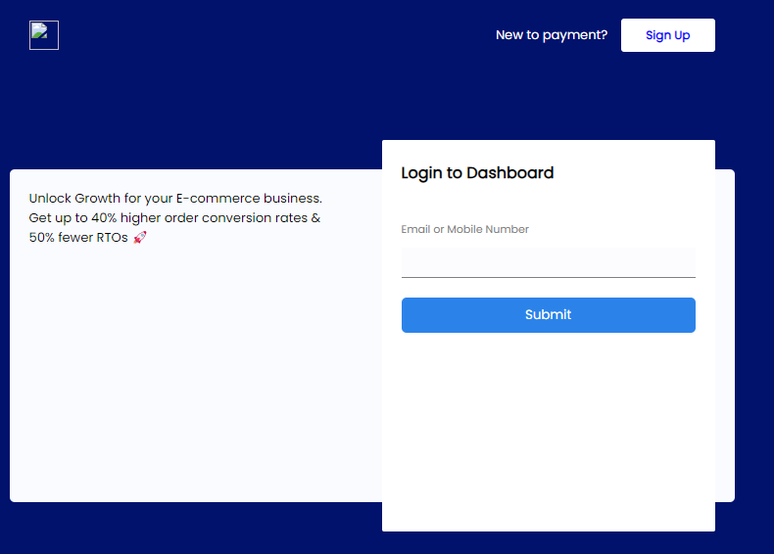
Screenshots

Slide 11
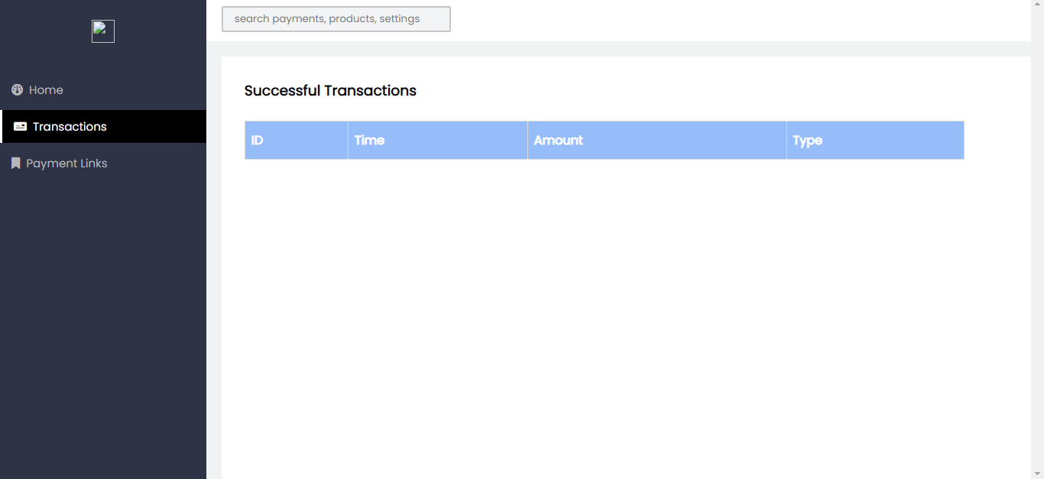
Screenshots

Slide 12
Conclusion
With the exponential growth of online transactions and the ever-evolving landscape of cyber threats, ensuring the integrity and confidentiality of sensitive financial data has become paramount.
Our developed a robust payment gateway system that not only meets the stringent security requirements of today but also anticipates the cryptographic challenges of tomorrow. Through meticulous research and development, we have leveraged the NTRU encryption algorithm, renowned for its quantum-resistant properties, to fortify our payment gateway against potential quantum attacks. By doing so, we have positioned our system at the forefront of quantum-safe cryptography, offering users peace of mind knowing that their transactions are shielded from emerging threats.
With our project, the future of online transactions is not only secure but also more inclusive and user-friendly than ever before.

Slide 13
Future Scope
Enhanced Security Measures: As cyber threats continue to evolve, implementing advanced security measures, such as biometric authentication or multi-factor authentication, can further fortify our payment gateway system against unauthorized access and fraudulent activities.
Integration with Emerging Technologies: Exploring the integration of emerging technologies like blockchain can revolutionize the landscape of online payments, offering unprecedented transparency, decentralization, and security. By leveraging blockchain technology, we can create a decentralized payment ecosystem that eliminates the need for intermediaries and enhances transactional integrity
Continuous Improvement and Optimization: Continuously refining and optimizing our payment gateway system based on user feedback and market trends is essential to stay competitive in the ever-evolving fintech landscape. By prioritizing user experience and leveraging data analytics, we can identify areas for improvement and implement iterative enhancements to enhance overall system performance and usability

Slide 14
Thank You

